Slide 1
Invitation to Quantum Information III
1st eduQUTE school on quantum technologies
Bratislava 19-22/02/2018
Daniel Reitzner
Research Center for Quantum Information, Slovak Academy of Sciences

Slide 2
Recapitulation
What have we learnt yesterday...

Slide 3
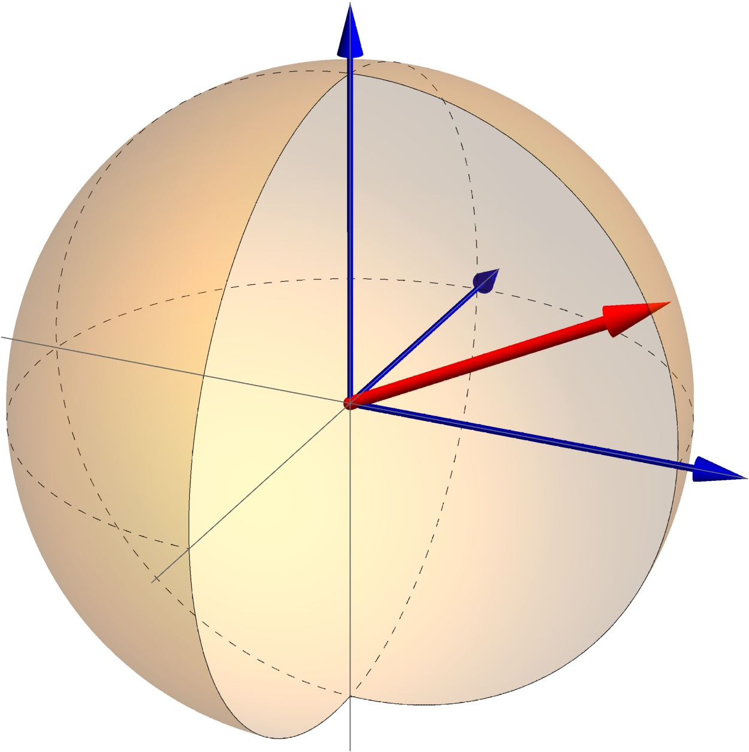
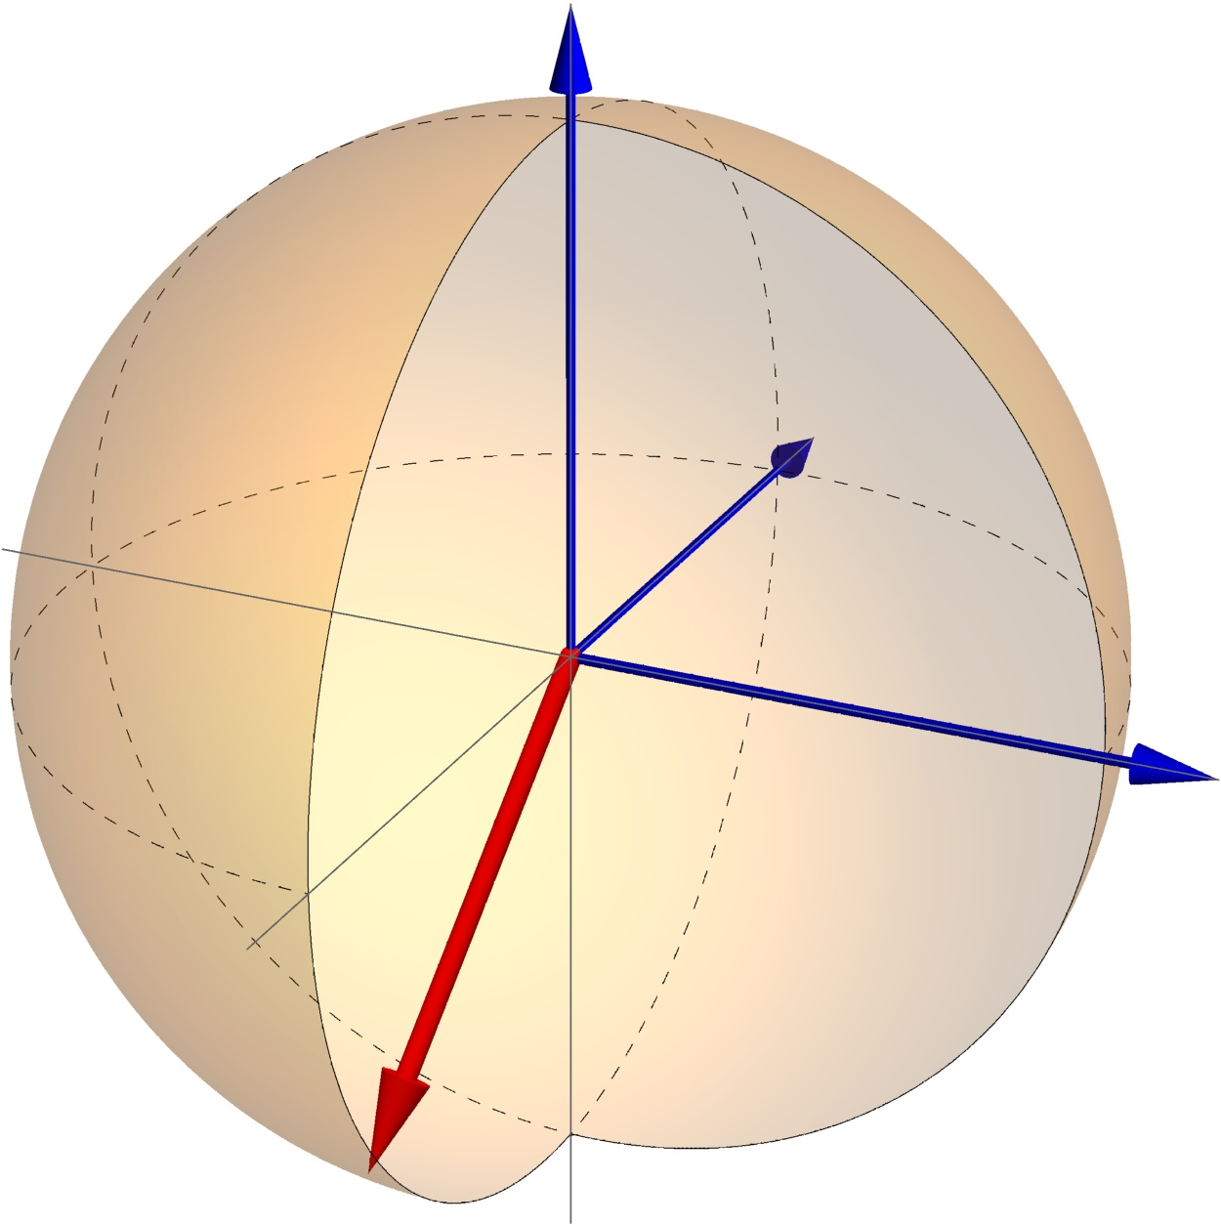
Recapitulation
Two-qubit Hilbert space
Basis states:
States are no longer representable by Bloch spheres!

Slide 4
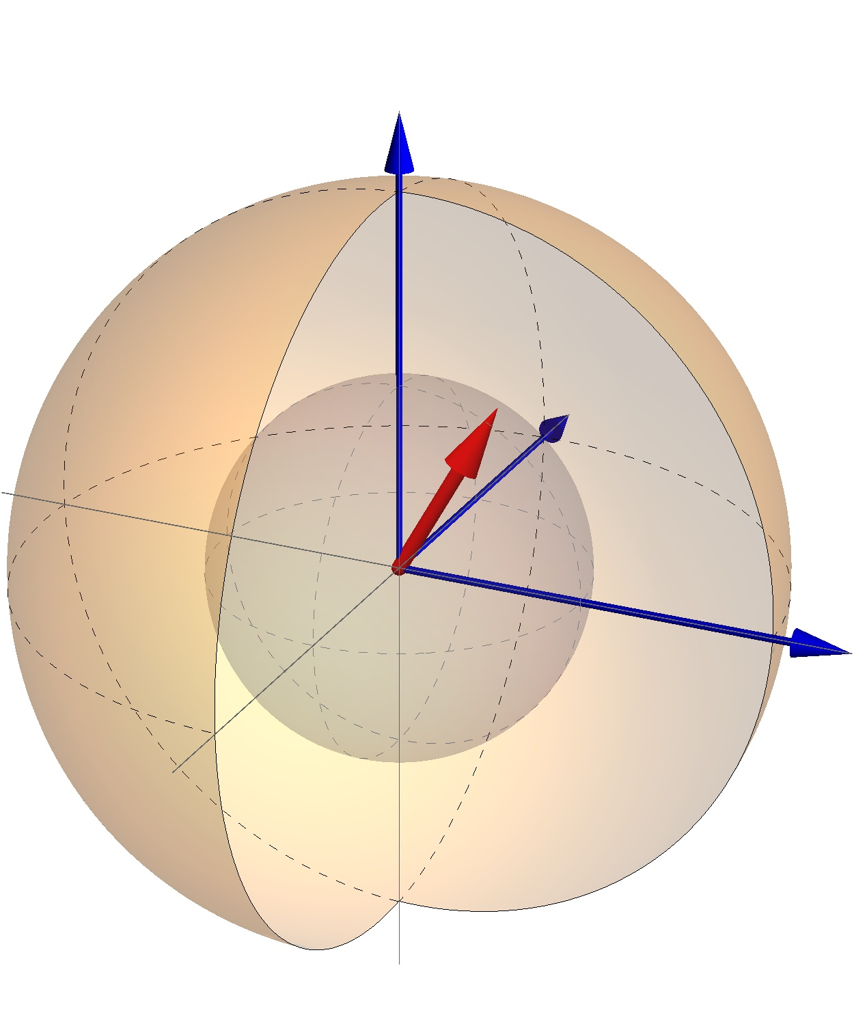
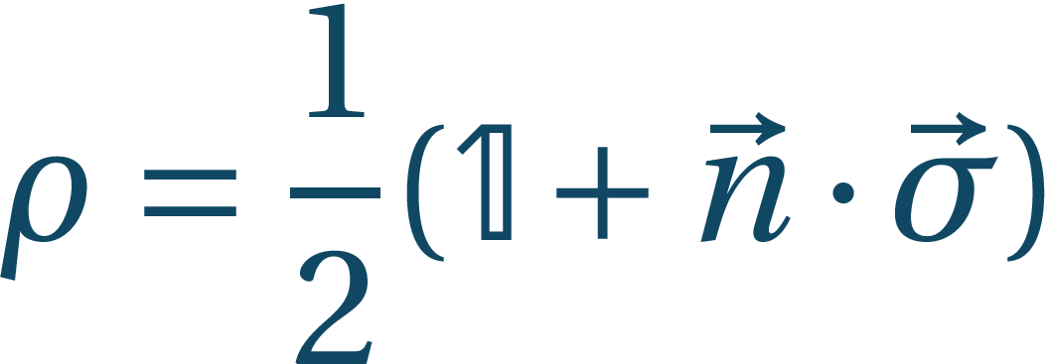
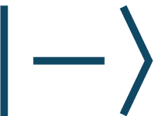
Recapitulation
Reduced state:
We can compactly write
If our basis are states and , probabilistic states lie on z-axis

Slide 5
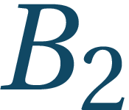
Recapitulation
By LOCC one can prepare any separable state from any other state – separable states are “weakest”
The “strongest” are the maximally entangled states from which one can prepare any other state by means of LOCC but these cannot be prepared locally
Alice
Bob

Slide 6
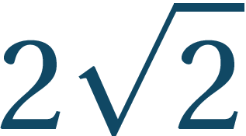
Recapitulation
Einstein, Podolsky, Rosen (1935) – spooky action at a distance
Let us have entangled state:
CHSH function
Under local realism , in quantum case
The violation of is maximal in QM (Tsireľson bound)
Alice: Earth
Bob: Andromeda galaxy
Einstein, A; B Podolsky; N Rosen – Can Quantum-Mechanical Description of Physical Reality be Considered Complete?, Phys. Rev. 47, 777–780 (1935)

Slide 7
IMPOSSIBLE QUANTUM DEVICES
Which make our quantum life harder

Slide 8
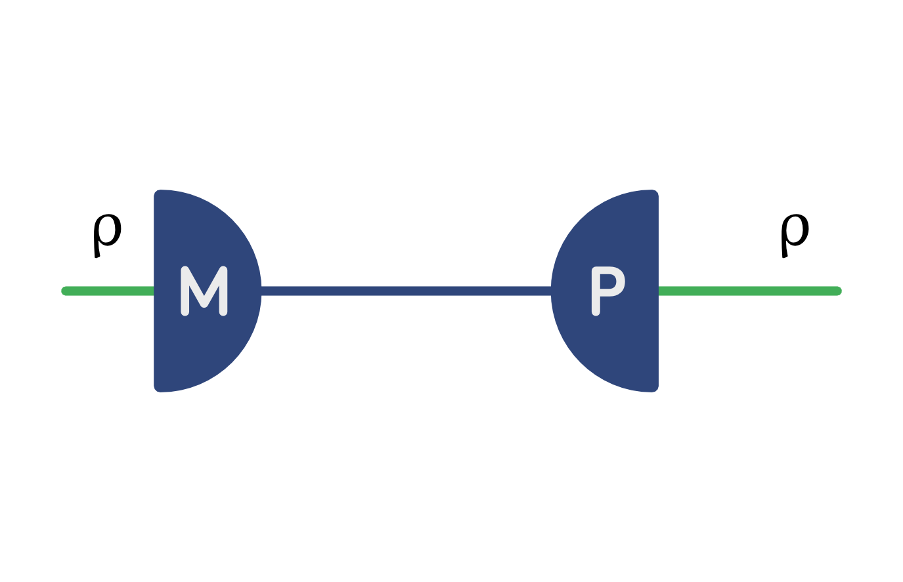
Impossible devices
Classical state transfer
R. Werner, Quantum Information Theory – An Invitation, arXiv:quant-ph/0101061, also Quantum information – an introduction to basic theoretical concepts and experiments”, Springer Tracts in Modern Physics

Slide 9
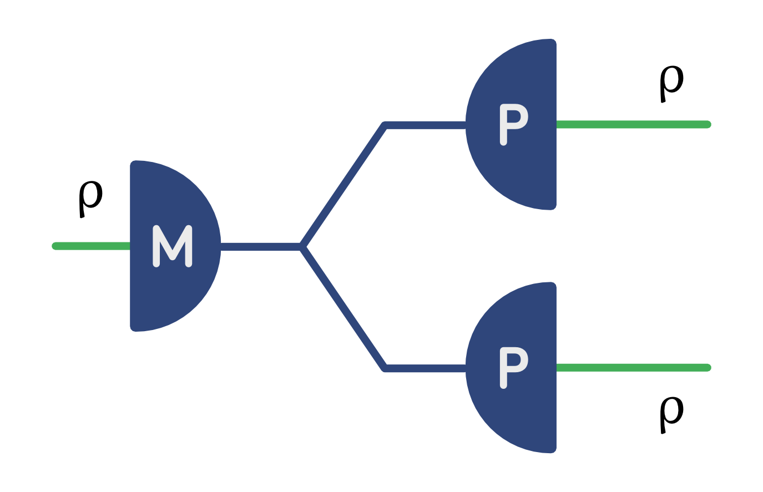
Impossible devices
Quantum cloning

Slide 10
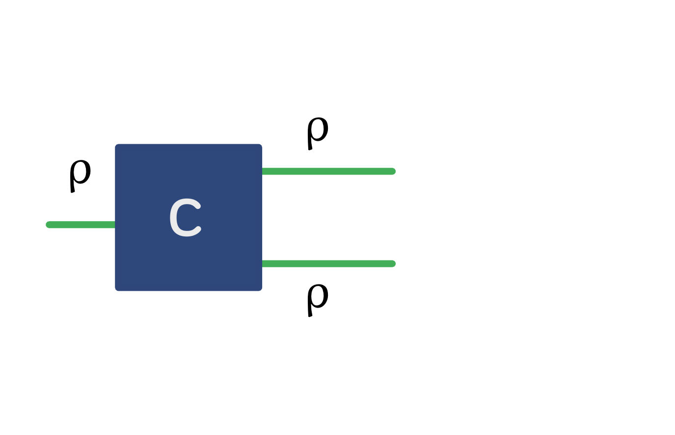
Impossible devices
Quantum cloning

Slide 11
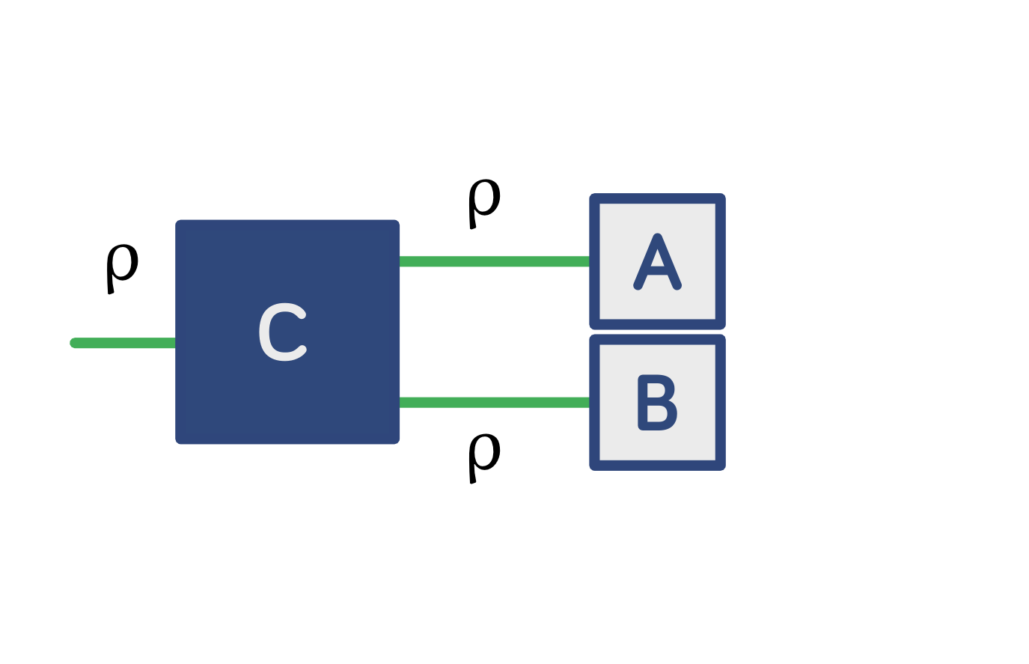
Impossible devices
Joint measurability

Slide 12
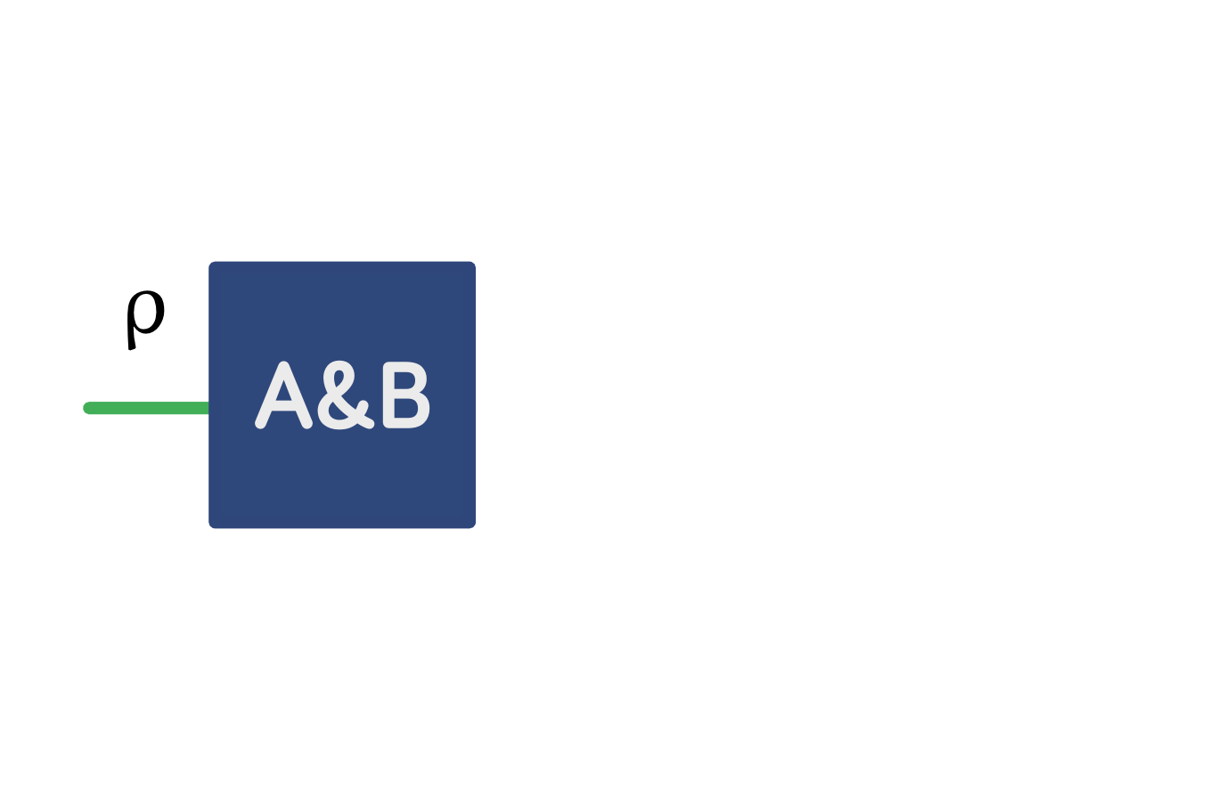
Impossible devices
Joint measurability

Slide 13
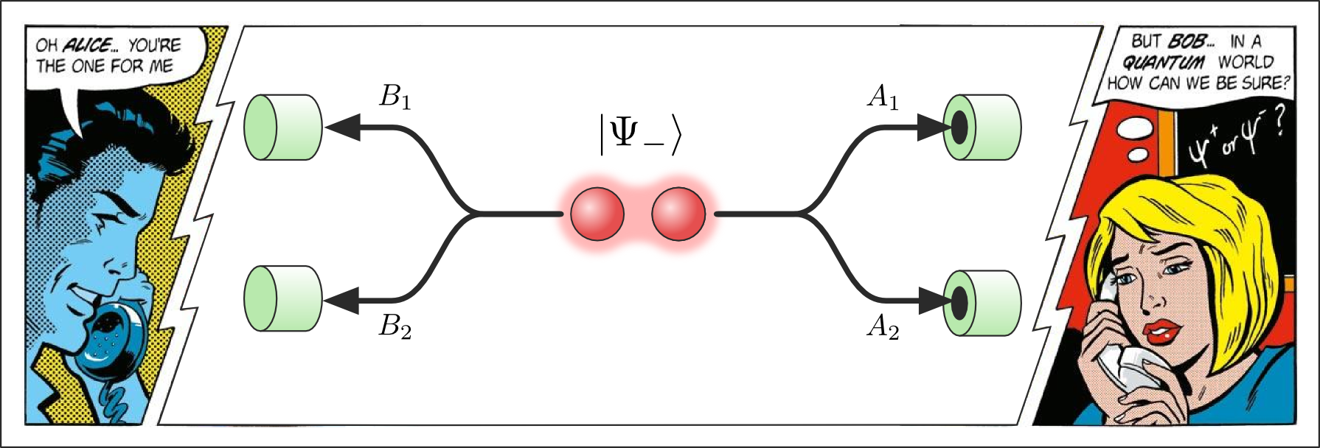
Impossible devices
Bell’s telephone
(C) John Richardson

Slide 14
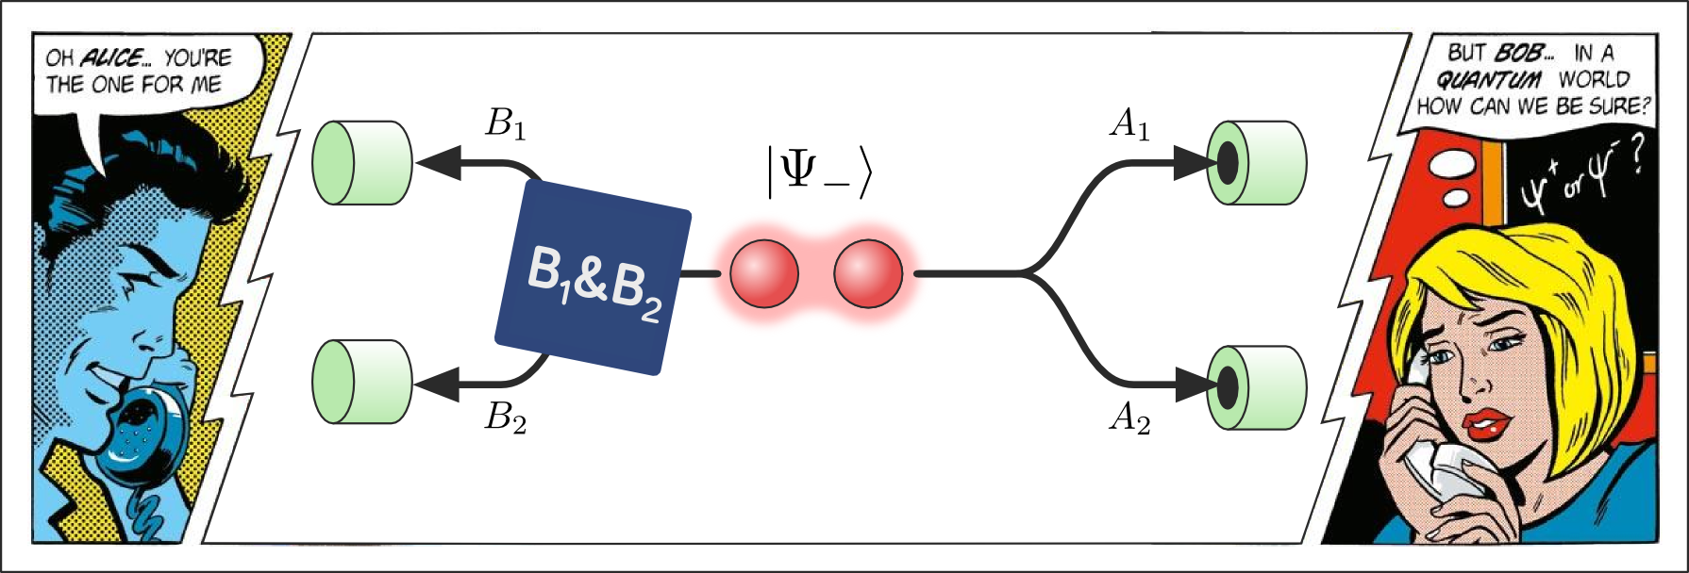
Impossible devices
Bell’s telephone
(C) John Richardson

Slide 15
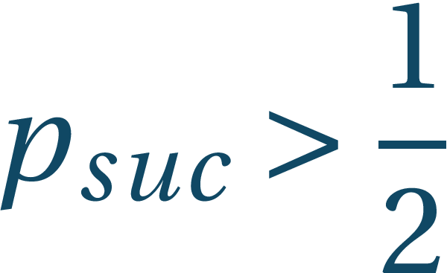
Impossible devices
Bell’s telephone
Let us set and suppose
We require and
Let us use encoding/decoding scheme:
Bob can successfully communicate with Alice if his guess probability

Slide 16
Impossible devices
Bell’s telephone
Bob’s success probability can be bounded from bellow as

Slide 17
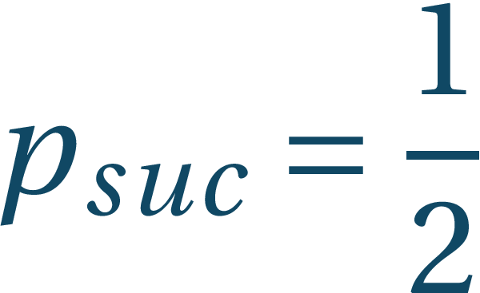
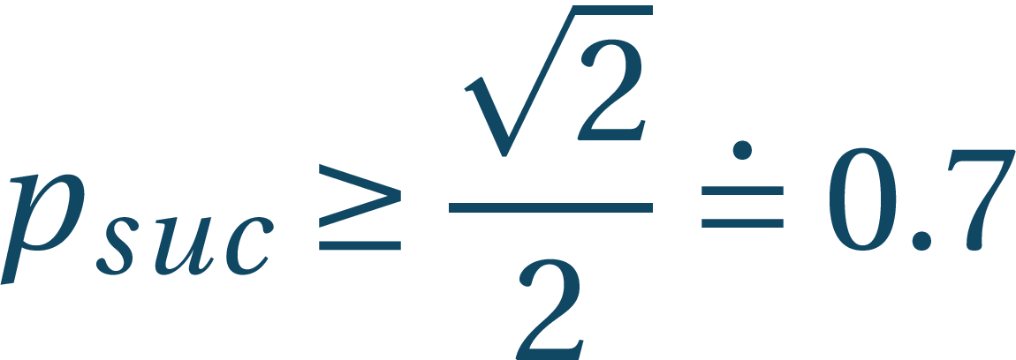
Impossible devices
Bell’s telephone:
Under local realism assumption: and
In the quantum case ; this would allow superluminal communication
Alice: Earth
Bob: Andromeda galaxy

Slide 18
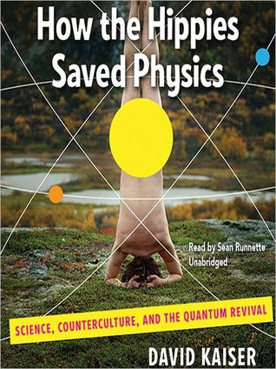
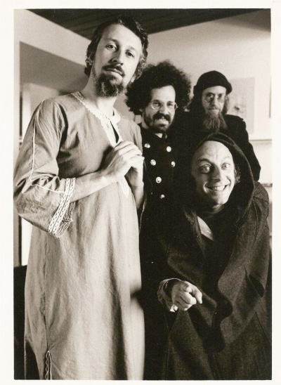
Cloning and FTL communication
Fundamental Fysiks Group (70s)

Slide 19
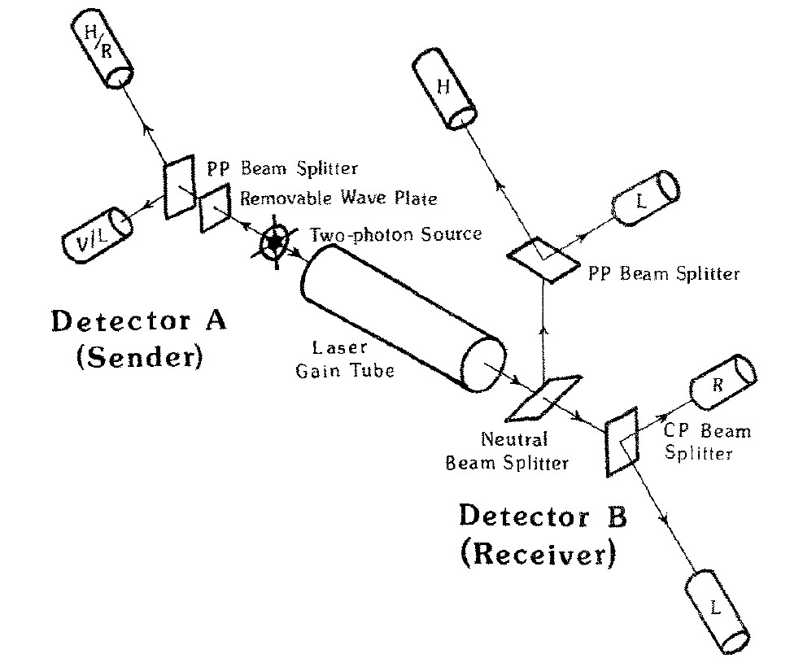
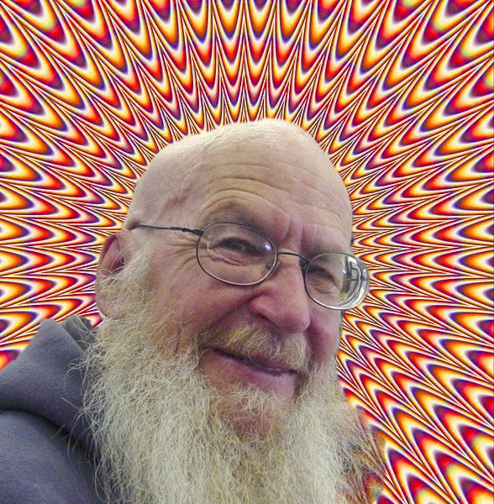
Cloning and FTL communication
Fundamental Fysiks Group (70s)
N. Herbert, FLASH* – A superluminal communicator based upon a new kind of quantum measurement
Foundations of Physics 12, 1171 (1982)
* First Laser-Amplified Superluminal Hookup

Slide 20
Impossible devices
Since superluminal communication is not possible and violation of CHSH inequality has been proven, the following devices are impossible:
Classical state transfer – metrology
Quantum cloning – No-cloning theorem – joint systems
Joint measurability – Incompatible measurements – generalized measurements
Bell’s telephone – Non-locality – joint systems and entanglement
Although there are impossible quantum devices that have a possible classical counterparts, there are also interesting possible quantum devices that do not have classical counterparts

Slide 21
POSSIBLE QUANTUM DEVICES
Entanglement as a resource and other stories

Slide 22
Bell basis
These are orthogonal, but we can make a full ortho-normal basis of maximally entangled states by taking
Conversely we can write

Slide 23
Superdense coding
Sending two bits per one use of quantum channel
We make use of the Bell basis:
This is a basis in which we can perform measurement, but this also shows possible preparation procedure of one of the states
Alice and Bob pre-share state
Encoding choice:
When Alice is ready to send her bits, based on the pair she applies one of the unitaries and then sends the qubit to Bob
Bob performs measurement in the Bell basis and based on the outcome he knows the bits Alice sent him
C. Bennett, S. Wiesner – Communication via one- and two-particle operators on Einstein-Podolsky-Rosen states, Phys. Rev. Lett. 69: 2881 (1992)

Slide 24
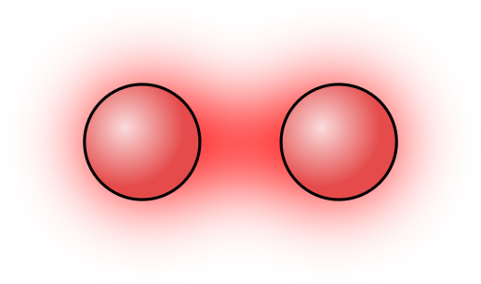
Superdense coding
Alice and Bob pre-share state
Encoding choice:

Slide 25
Superdense coding
Alice and Bob pre-share state
Encoding choice:
Alice: Earth
Bob: Andromeda galaxy

Slide 26
Superdense coding
Alice and Bob pre-share state
Encoding choice:
Alice: Earth
Bob: Andromeda galaxy
Measurement in
Bell Basis

Slide 27
Quantum teleportation
Similar to dense coding, but now it is 2 bits of classical information that transfers full information about quantum state
C. H. Bennett, G. Brassard, C. Crépeau, R. Jozsa, A. Peres, W. K. Wootters – Teleporting an Unknown Quantum State via Dual Classical and Einstein–Podolsky–Rosen Channels, Phys. Rev. Lett. 70, 1895–1899 (1993)

Slide 28
Quantum teleportation
Similar to dense coding, but now it is 2 bits of classical information that transfers full information about quantum state
Alice: Earth
Bob: Andromeda galaxy

Slide 29
Quantum teleportation
Similar to dense coding, but now it is 2 bits of classical information that transfers full information about quantum state
Alice: Earth
Bob: Andromeda galaxy
Measurement in
Bell Basis

Slide 30
Quantum teleportation
How does it work? Composite state before Alice measures it is
If then
We measure in the Bell basis and use:
Now

Slide 31
Quantum teleportation
Measuring the state in Bell basis gives each result with the same probability ¼ and gives two bits of classical information about the transformation Bob needs to make to transform his state to :
This holds because

Slide 32
Quantum teleportation
Similar to dense coding, but now it is 2 bits of classical information that transfers full information about quantum state
Alice: Earth
Bob: Andromeda galaxy
Measurement in
Bell Basis

Slide 33
BB84
C. H. Bennett, G. Brassard – Quantum cryptography: Public key distribution and coin tossing, In Proc. IEEE International Conference on Computers, Systems and Signal Processing, Vol. 175, page 8 (1984)
Similar to B92, but instead of one particle that Alice sends, Bob and Alice share entangled states
More robust setup
(C) John Richardson

Slide 34
BB84
C. H. Bennett, G. Brassard – Quantum cryptography: Public key distribution and coin tossing, In Proc. IEEE International Conference on Computers, Systems and Signal Processing, Vol. 175, page 8 (1984)
Measurements are and chosen randomly by both
If their choices coincide (public info.) they know their outcomes are opposite (private key, Bob just flips his bit)
(C) John Richardson

Slide 35
BB84
C. H. Bennett, G. Brassard – Quantum cryptography: Public key distribution and coin tossing, In Proc. IEEE International Conference on Computers, Systems and Signal Processing, Vol. 175, page 8 (1984)
If there would be an eavesdropper, she would be easily detected in the same way as in B92
(C) John Richardson

Slide 36
Summary
Although some procedures are impossible in quantum mechanics, some are unique and offer possibilities beyond classical physics:
Using entanglement we can send more information than without it
We can also send quantum information by using entanglement and classical communication
We can communicate securely
Although some procedures are impossible, they have approximations

Slide 37
Other quantum devices
Amendment to the impossible ones

Slide 38
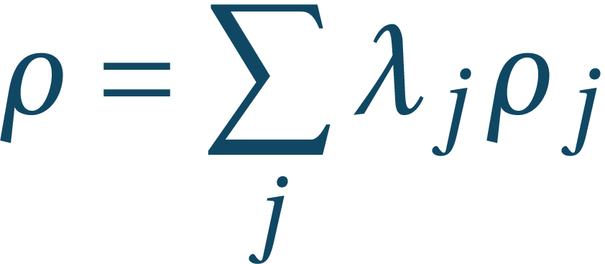
No-cloning theorem
We now know that cloning of quantum information is not possible, but we can show it also explicitly
The cloning machine should transform
Let , then on one hand and on the other hand due to the linearity
In general these two do not agree (take to be ONB)
W.K. Wooters, W.H. Zurek, Nature 299, 802 (1982)

Slide 39
Approximate cloning
So perfect cloning is impossible, but we can at least clone with some disturbance to the state
Let us consider symmetric cloning
A
B
R
V. Bužek, M. Hillery – Quantum Copying: Beyond the no-cloning theorem, Phys. Rev. A 54, 1844 (1996)

Slide 40
Approximate cloning
So perfect cloning is impossible, but we can at least clone with some disturbance to the state
Let us consider symmetric cloning by unitary rules:
What happens to state :
V. Bužek, M. Hillery – Quantum Copying: Beyond the no-cloning theorem, Phys. Rev. A 54, 1844 (1996)

Slide 41
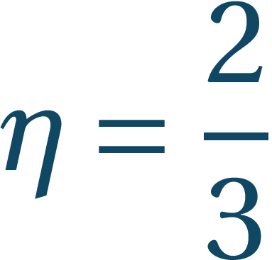
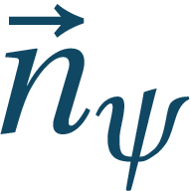
Approximate cloning
What happens to state :
Reduced states: where
The Bloch vector shrining factor is optimal
In general the quantum information from input(s) is diluted to outputs
V. Scarani, S. Iblisdir, N. Gisin – Quantum cloning, Rev. Mod. Phys. 77, 1225 (2005)

Slide 42
Impossible devices
*
Bell’s telephone
(C) John Richardson

Slide 43
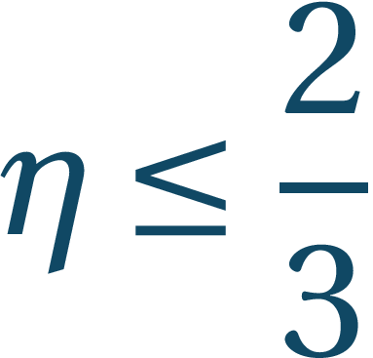
Cloning and FTL communication
If we would go beyond Bužek-Hillery bound, we would be able to communicate superluminally
Let , then
Using some properties we impose on (equal action on all states, no-signaling*) one can find
N. Gisin – Quantum cloning without signaling, Phys. Lett. A 242, 1 (1998)
* Mixtures of output states corresponding to indistinguishable mixtures of input states are themselves indistinguishable

Slide 44
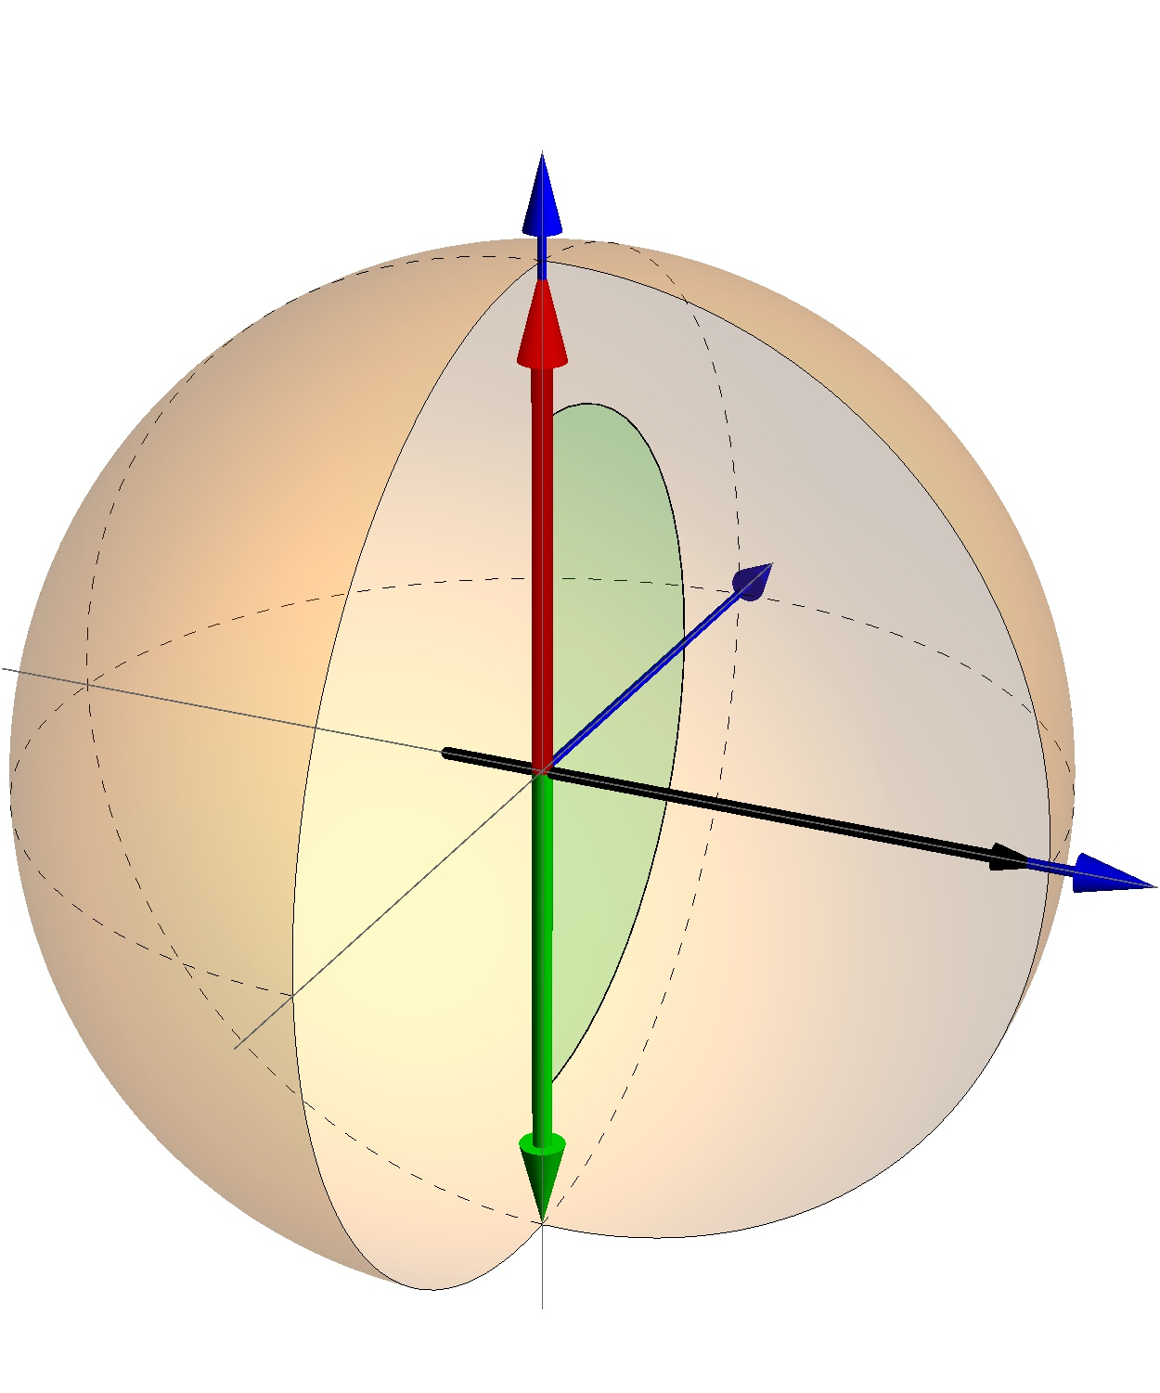
Universal NOT
The NOT operation is a unitary that reverses
It does nothing to states
Does there exist a procedure that would transform any state to orthogonal ? In Bloch picture

Slide 45
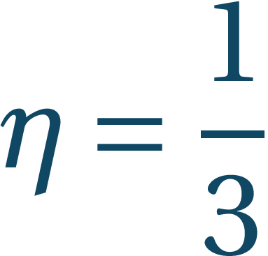
Universal NOT
The NOT operation is a unitary that reverses
It does nothing to states
Does there exist a procedure that would transform any state to orthogonal ? In Bloch picture
Such unitary does not exist! (Antiunitary)
Approximations – the best possibility comes from the cloning procedure:
Also here the shrinking factor is optimal

Slide 46
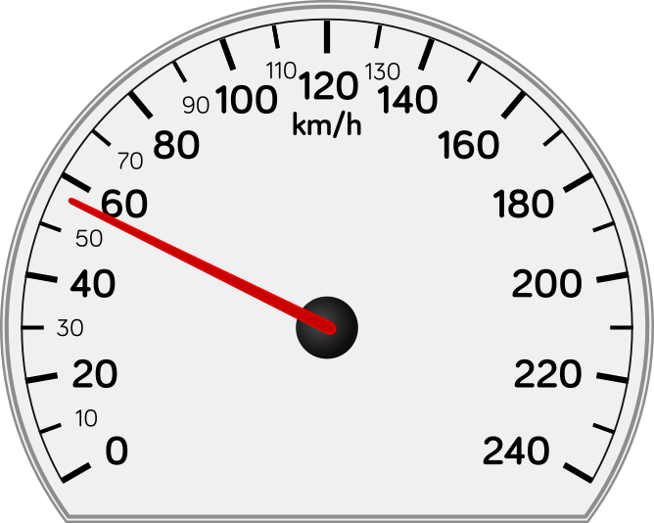
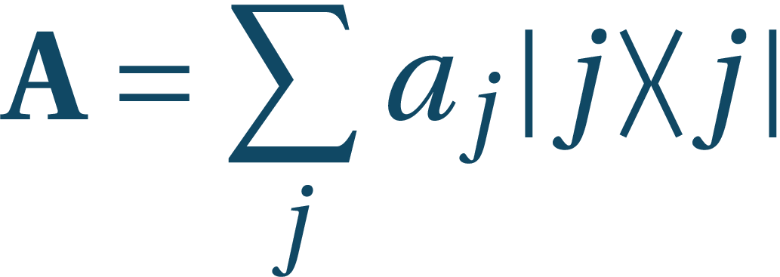
Generalized measurements
Similar to state “fuzzification”
Observables are self-adjoint operators:
Numbers just label the outcomes
Average value in state : with

Slide 47
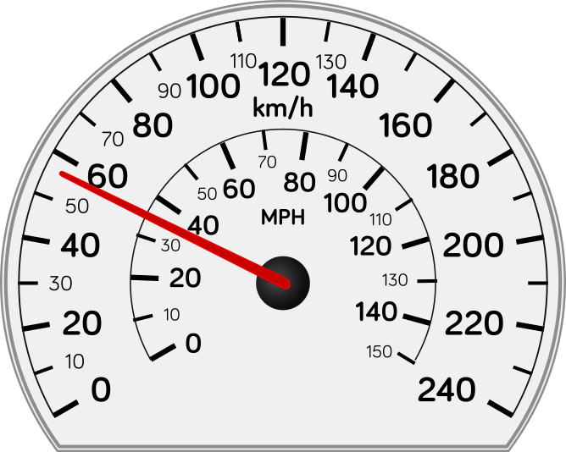
Generalized measurements
Similar to state “fuzzification”
Observables are self-adjoint operators:
Numbers just label the outcomes
Average value in state : with

Slide 48
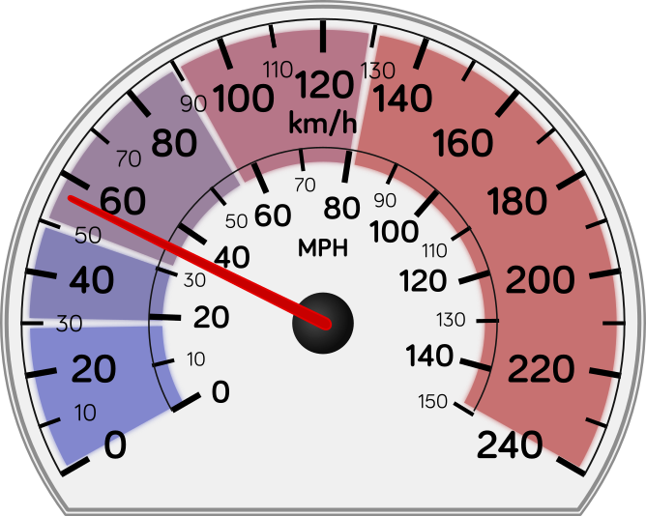
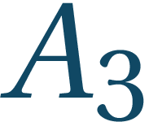
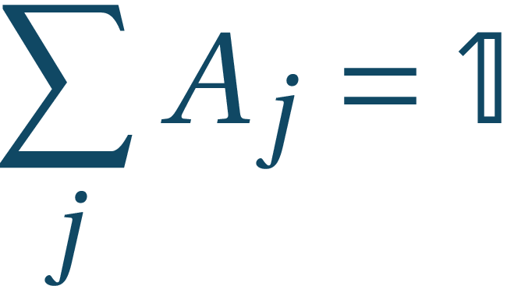
Generalized measurements
Similar to state “fuzzification”
Observables are self-adjoint operators:
Numbers just label the outcomes
Average value in state : with
Getting rid of outcomes, measurements are described by the set such that

Slide 49
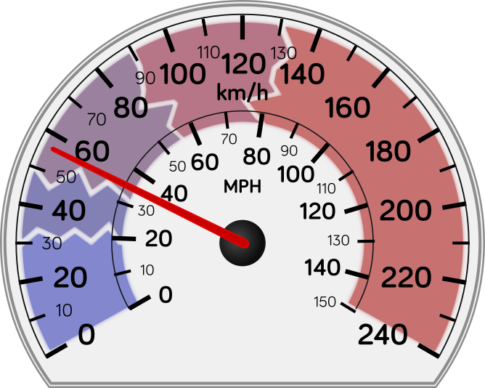
Generalized measurements
Similar to state “fuzzification”
Observables are self-adjoint operators:
Numbers just label the outcomes
Average value in state : with
Getting rid of outcomes, measurements are described by the set such that
Measurements (POVM’s – positive operator valued measure) are described by the set (of effects) such that

Slide 50
Generalized measurements
Similar to state “fuzzification”
Measurements (POVM’s – positive operator valued measure) are described by the set (of effects) such that
Probability of measuring j:
For qubits
If , then
This implies that if and only if and

Slide 51
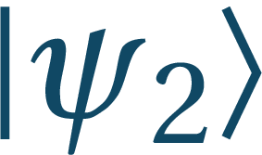
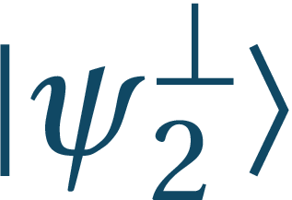
State discrimination
B92: Alice prepared either state or state and Bob measured with probability ½ in basis and with probability ½ in basis
Bob was effectively performing measurement (POVM) with effect being indeterminate (thrown away)
Effect is necessary whenever the discriminated states are non-orthogonal and we need to be sure about other outcomes
Success probability was
M. Sedlák – Quantum theory of unambiguous measurements, Acta Physica Slovaca 59, 653 (2009)

Slide 52
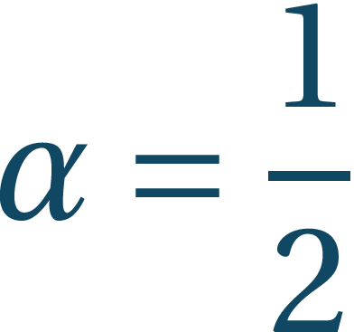
State discrimination
B92: Alice prepared either state or state and Bob measured with probability ½ in basis and with probability ½ in basis
Bob can perform measurement (POVM) with with effect being indeterminate (thrown away) and valid for
Success probability is which is optimal
For we recover previous result
The fail probability gives measure of closeness of states – fidelity

Slide 53
Summary
Some impossible quantum devices have approximations
We can clone approximately – the quantum information from input(s) dilutes to outputs
This approximation is exactly such that the superluminal communication is forbidden
Quantum cloner offers also a possibility of performing optimal general NOT
Quantum measurements can deal (to some extent) with non-orthogonality of states

Slide 54
THE END!
I hope I have conveyed information that...
Quantum mechanics contains strange effects...
That not only make our life harder...
But which also offer new possibilities such as...
Faster computation and safer communication...

