Slide 1
Invitation to Quantum Information II
1st eduQUTE school on quantum technologies
Bratislava 19-22/02/2018
Daniel Reitzner
Research Center for Quantum Information, Slovak Academy of Sciences

Slide 2
Recapitulation
What have we learnt yesterday...

Slide 3
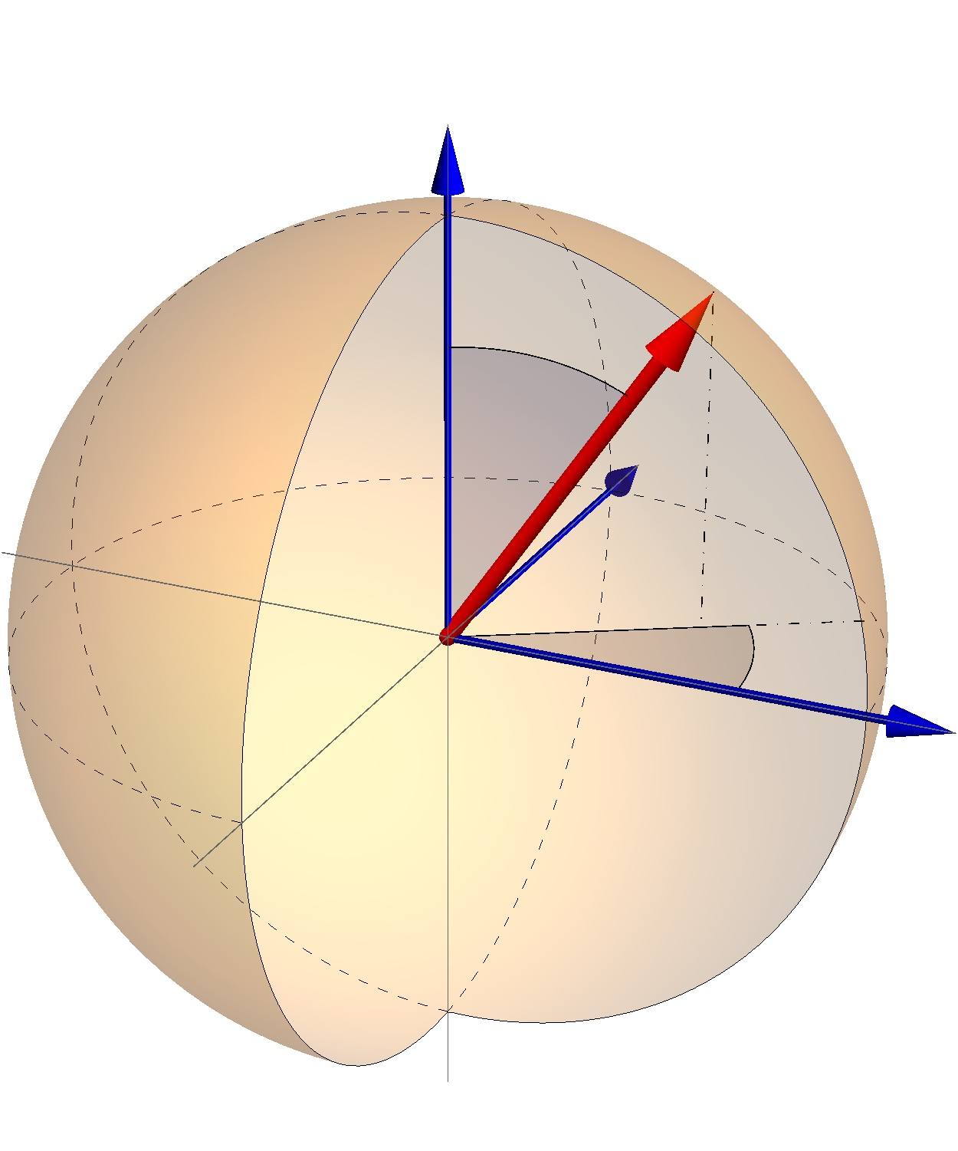
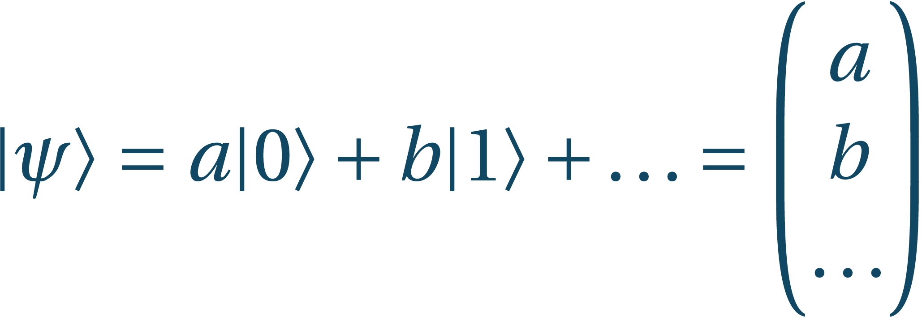
Recapitulation
Quantum mechanics – unprecedented precision
States:
Classical bit → qubit (quantum bit)
Qubits:
Orthogonal states: antipodal vectors on Bloch sphere

Slide 4
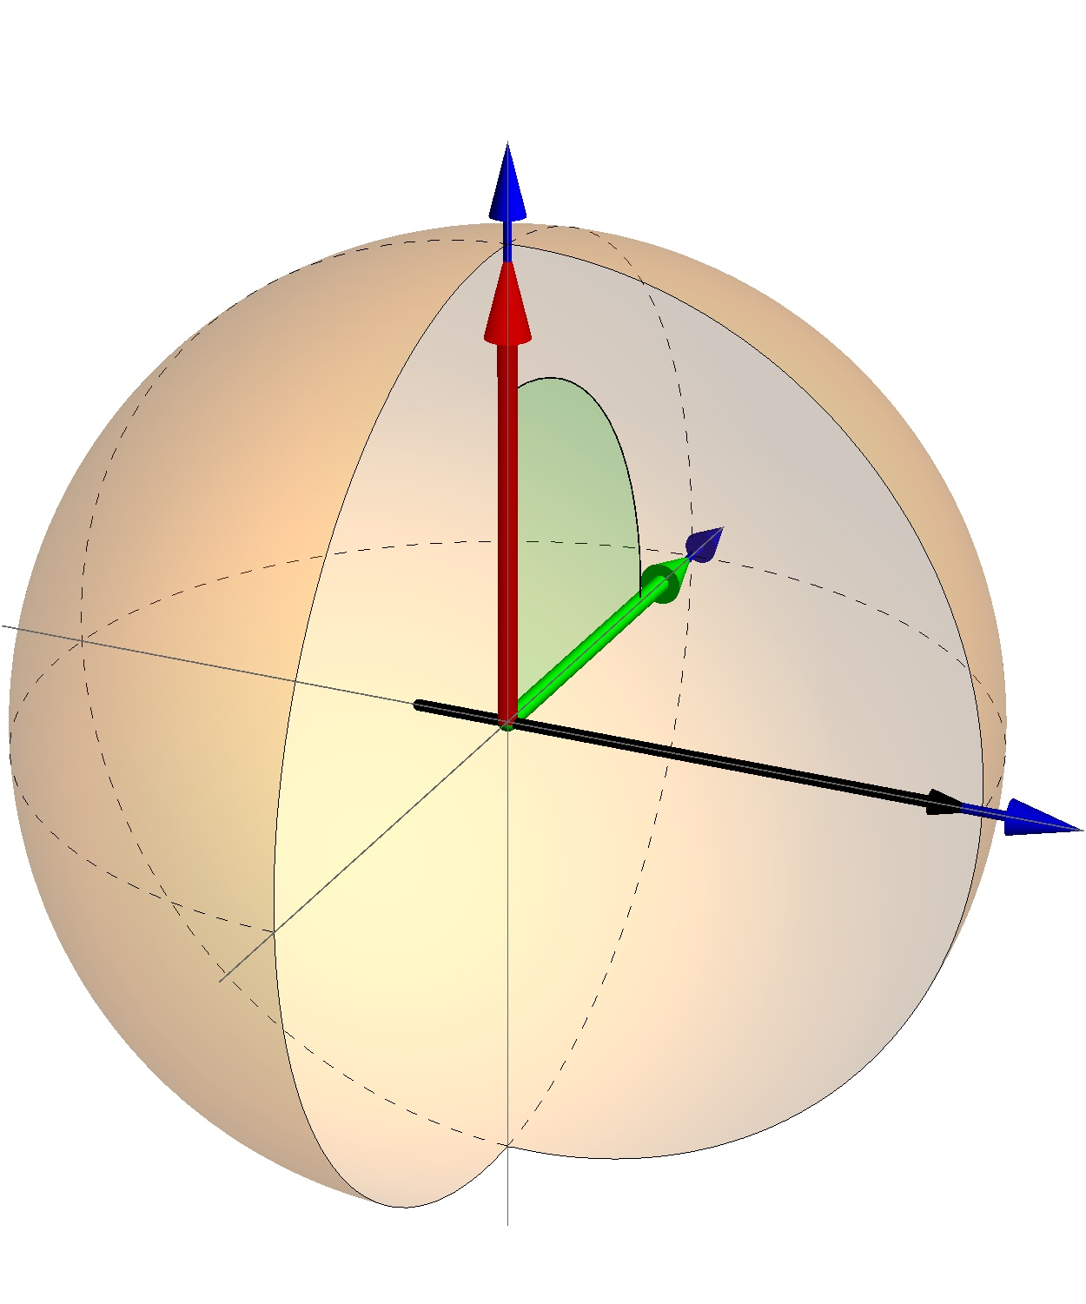
Recapitulation
Unitary evolutions are rotations
Interesting unitaries:
Unitaries define bases:

Slide 5
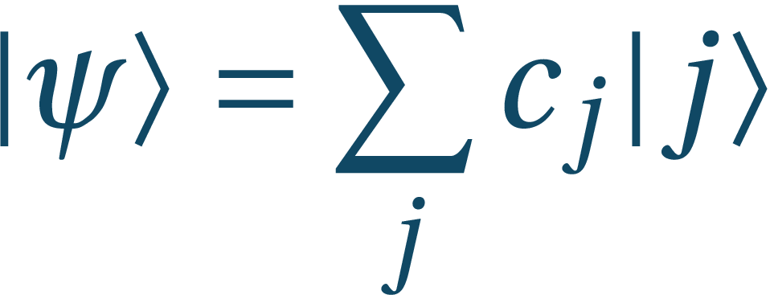
Recapitulation
A state in the basis of measurement can be written
Measurement gives outcome j with probability
The state after measurement becomes
For example measuring the state in base :
Measurement outcomes:
Global phases are not measurable

Slide 6
TWO qubits
...are better than one

Slide 7
One qubit alone needs a friend

Slide 8
Bipartite systems
Hilbert space of a composite system A-B is the tensor product
If system A is prepared in state and system B in state , the composite state is
The states where and are basis states for systems A and B, form orthonormal basis of the composite system with inner product
The tensor product operator acts on subsystems separately:
It can act on one of the systems trivially:
Alice: Earth
Bob: Andromeda galaxy

Slide 9
Measurements on bipartite systems
Measurement on part of the system
Spectral decomposition of composite observable is
The general state
The measurement yields result j with probability and the post-measurement state is

Slide 10
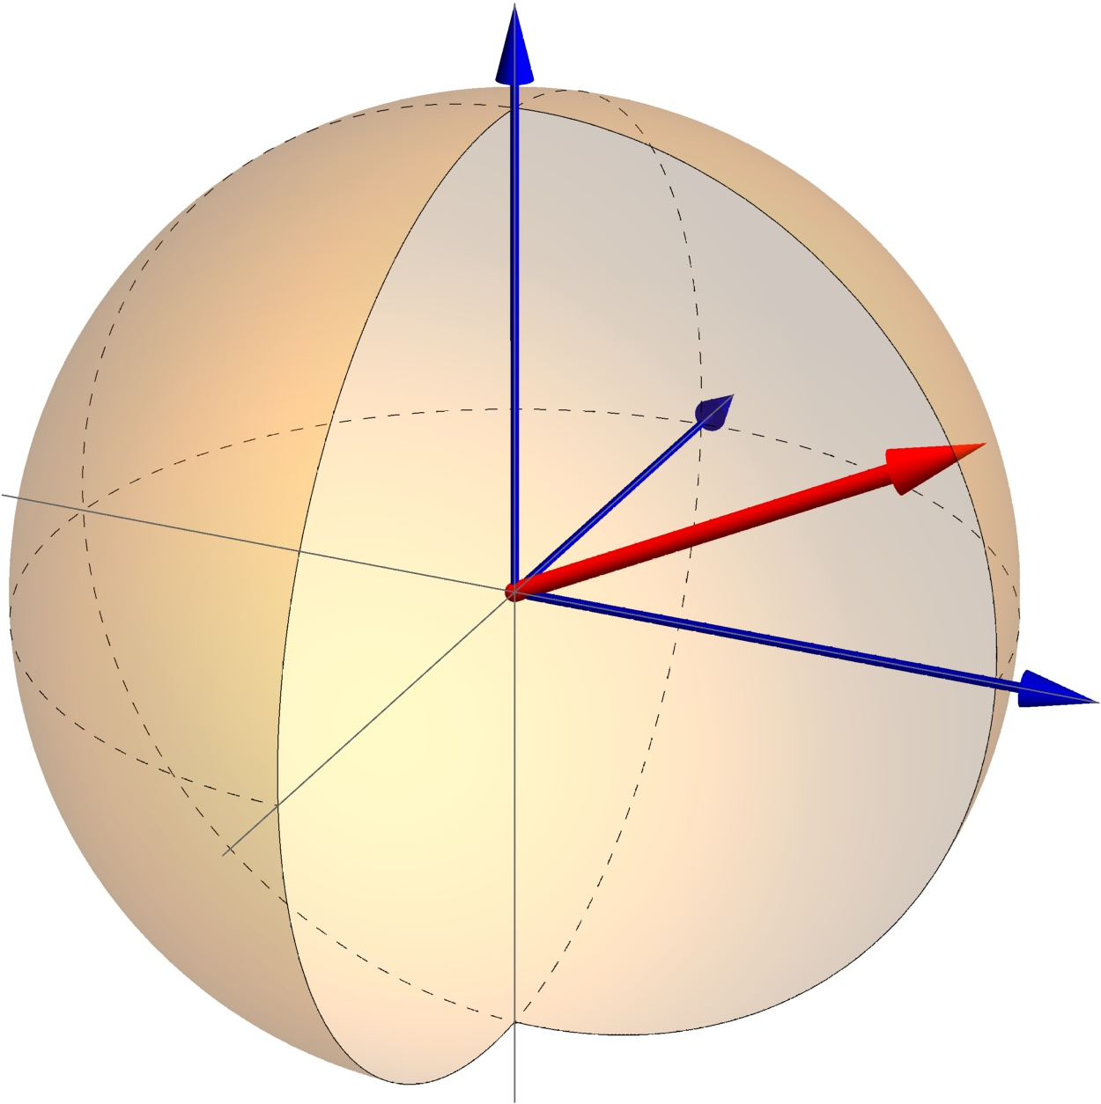
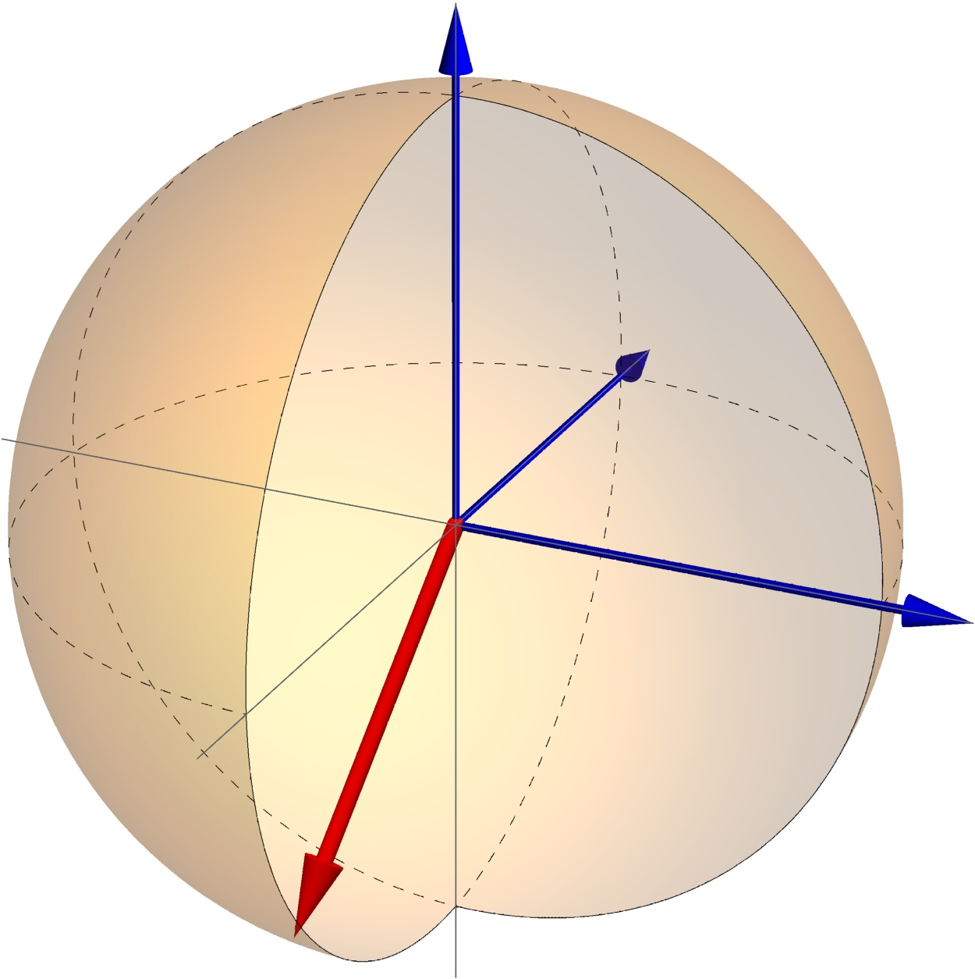
Bringing qubits together
Two-qubit Hilbert space
Basis states:
States are no longer representable by Bloch spheres!

Slide 11
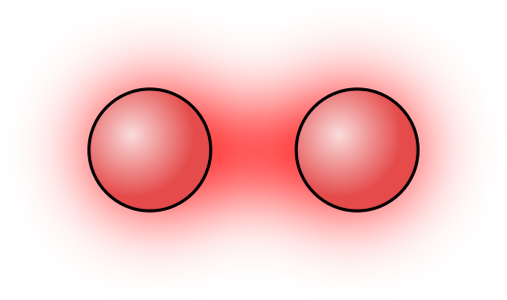
Bringing qubits together
Two-qubit Hilbert space
Basis states:
States are no longer representable by Bloch spheres!

Slide 12
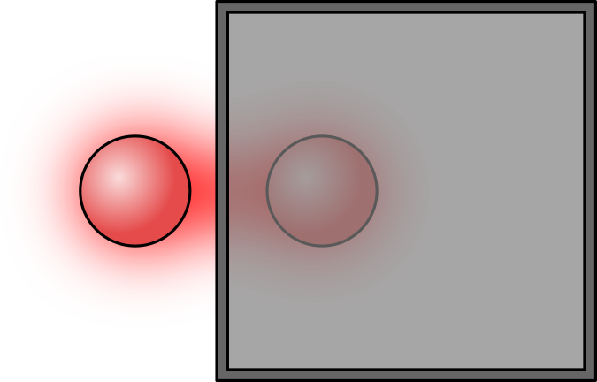
Density operator
Having a bipartite system A-B, we might only have access to one of its parts, let’s say A and B might be inaccessible
B might be e.g. environment, or part of the state sent to Bob in Andromeda galaxy
Our description of state is - we shall call it the density operator
B
A

Slide 13
What is this density operator?
In general let
Then all information accessible to us is with
State is obtained by taking the partial trace over the system B, which removes all the information about the state that is present at site B
Every such state has following properties:
Is self-adjoint:
Has trace 1:
Is a positive operator:

Slide 14
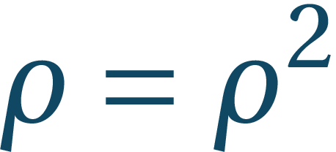
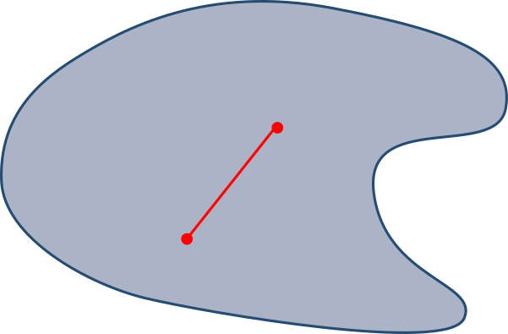
What is this density operator?
Pure state has density operator which is a projection so for pure states
If the state is not pure, we call it mixed; then
Set of density operators is convex: for any and density operators and the operator is a density operator

Slide 15
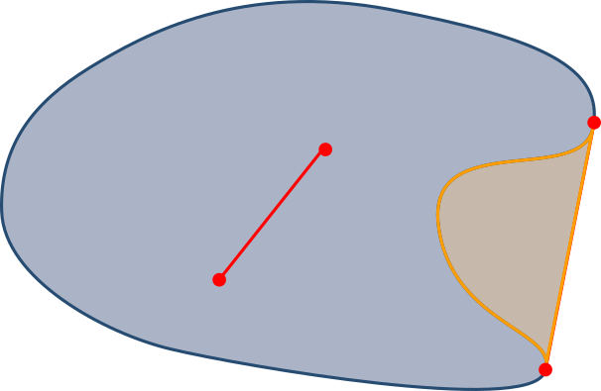
What is this density operator?
Pure state has density operator which is a projection so for pure states
If the state is not pure, we call it mixed; then
Set of density operators is convex: for any and density operators and the operator is a density operator

Slide 16
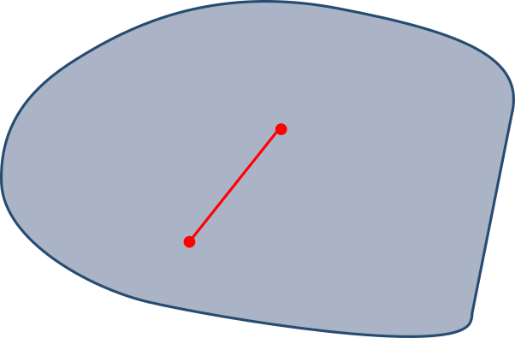
What is this density operator?
Pure state has density operator which is a projection so for pure states
If the state is not pure, we call it mixed; then
Set of density operators is convex: for any and density operators and the operator is a density operator

Slide 17
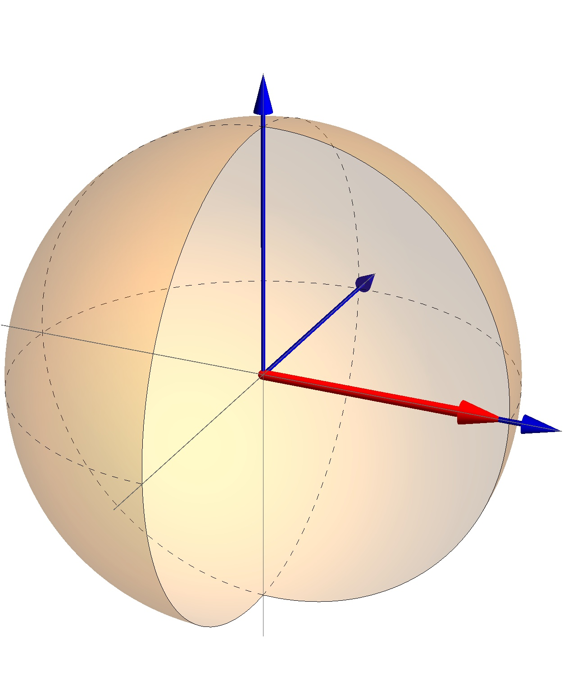
What is this density operator?
The state can be interpreted as a statistical mixture of preparations of states and with equal probabilities
How is this different from state ? Eigenvectors of are states and with eigenvalues and so measurement of will give outcome +1 with probability 1:
Statistical mixture will give both outcomes with equal probabilities:
So the differences are measurable! Mixed states represent probabilistic influence in our description of the states stemming from our limited knowledge

Slide 18
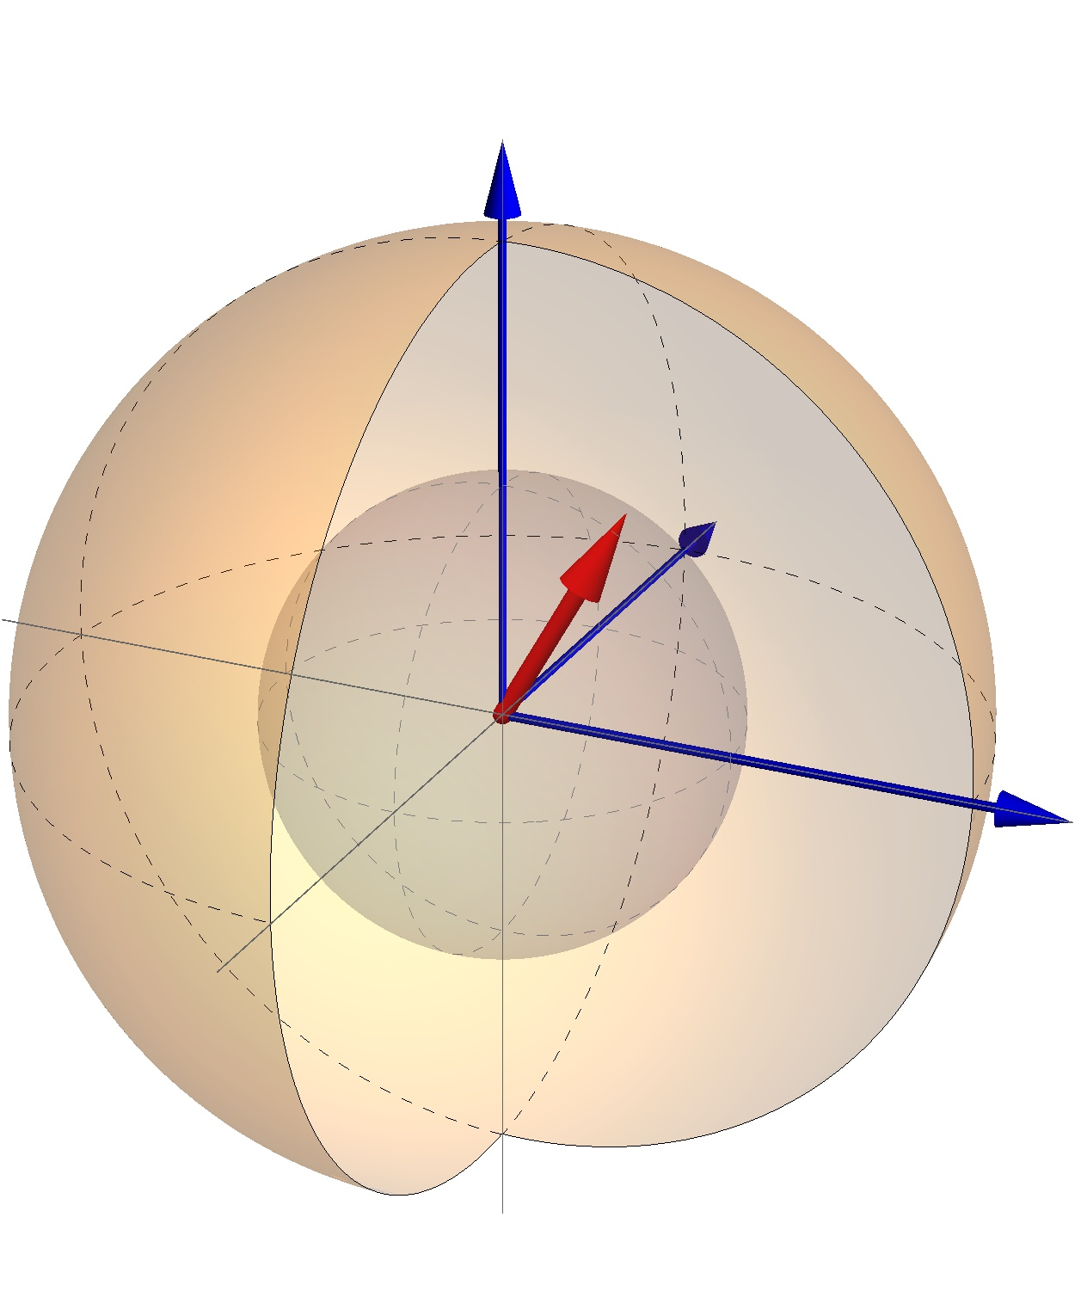
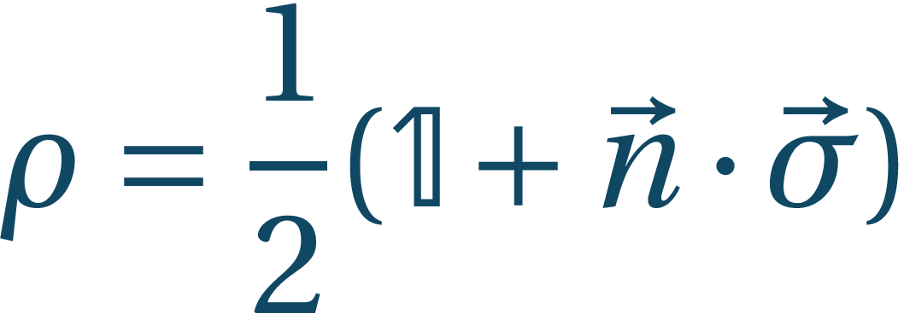
Qubit case – return of the Bloch ball
We can compactly write
If our basis are states and , probabilistic states lie on z-axis

Slide 19
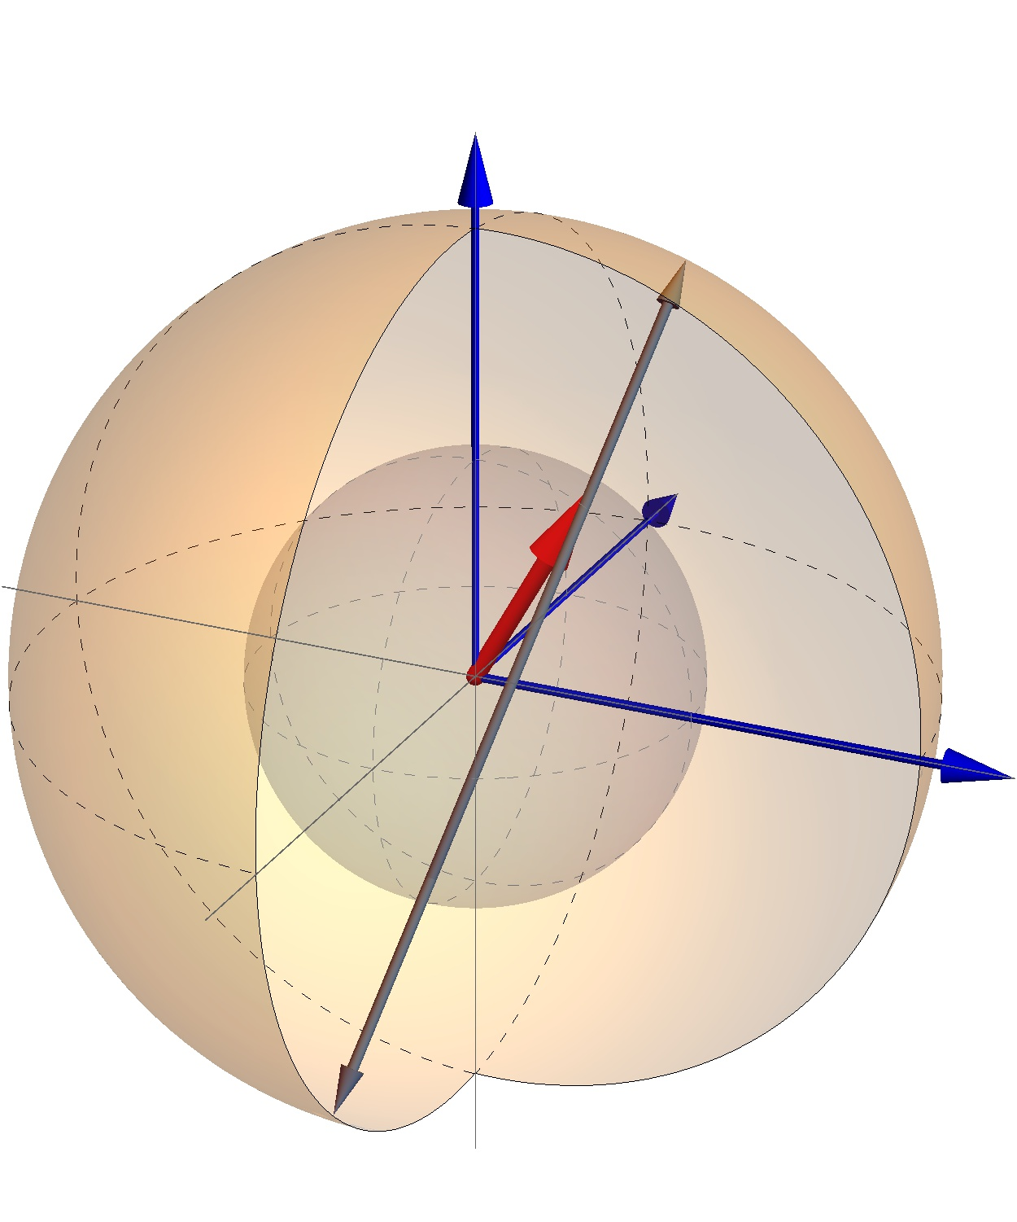
Qubit case – return of the Bloch ball
We can compactly write
If our basis are states and , probabilistic states lie on z-axis
convexity – different ways of preparation

Slide 20
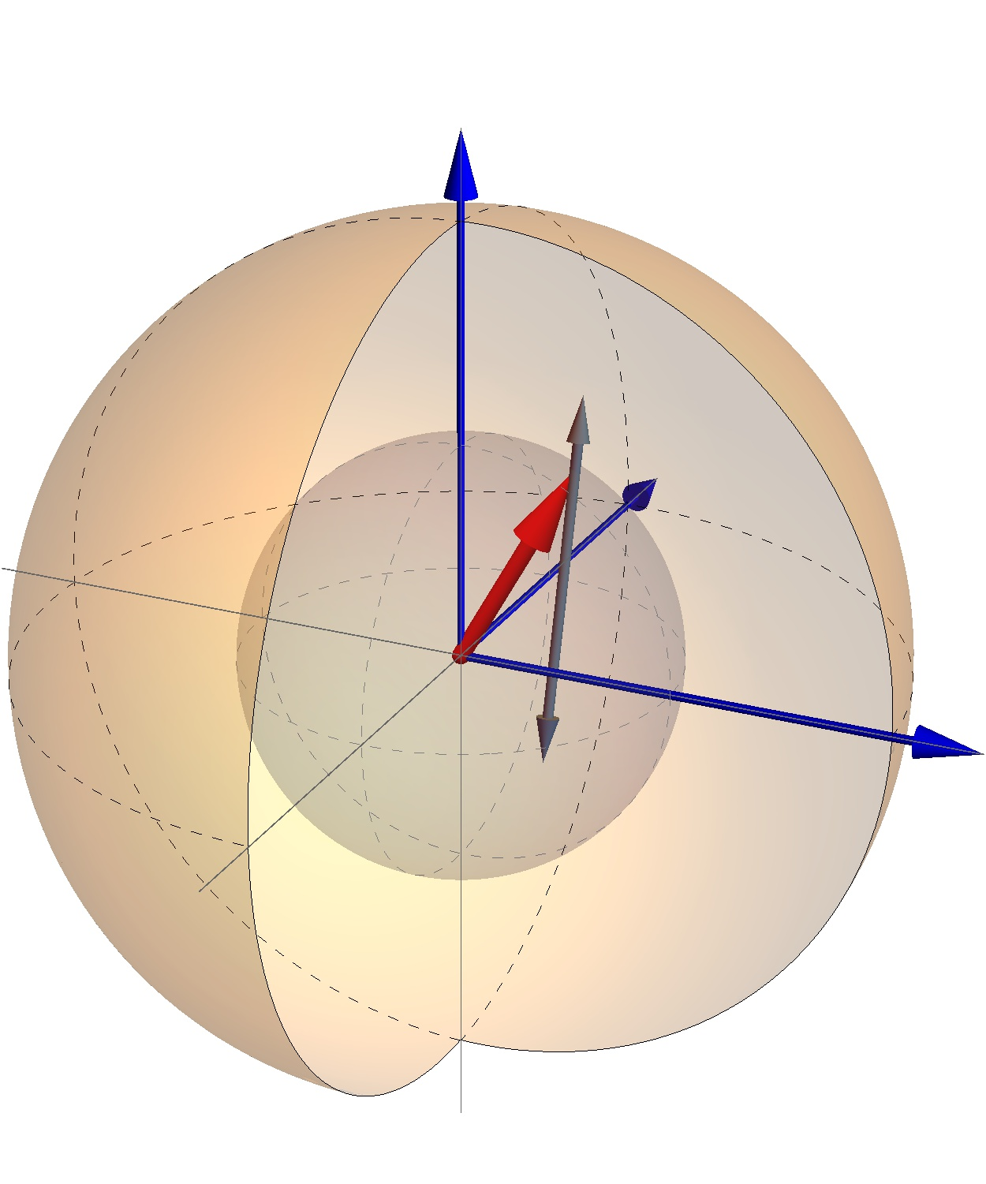
Qubit case – return of the Bloch ball
We can compactly write
If our basis are states and , probabilistic states lie on z-axis
convexity – different ways of preparation

Slide 21
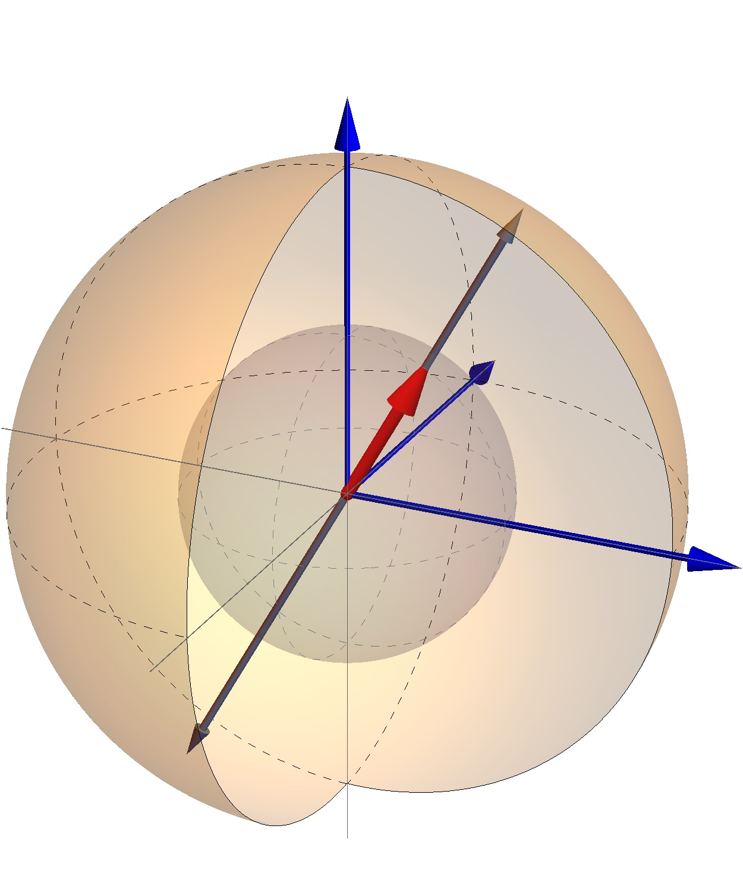
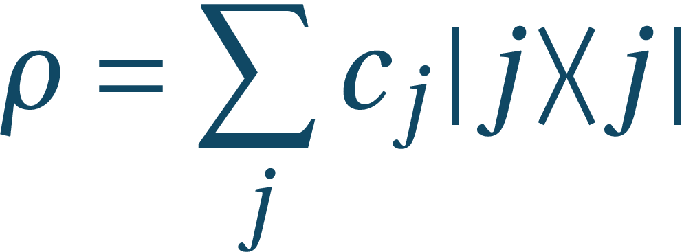
Qubit case – return of the Bloch ball
We can compactly write
If our basis are states and , probabilistic states lie on z-axis
convexity – different ways of preparation
Hermiticity implies:
ensemble preparations are not unique – locally we cannot know how such state was prepared (unless it is pure)

Slide 22
Summary
Multipartite systems are not just sums of its constituents
One view can present a system as a part of a larger one without our access to the other part (open system); this brings new terminology – density matrices
States in mixed states can be prepared in many ways
They have preferred basis
Note: in the same way as we treated states by tracing out one of their parts we can do the same also to:
Observables – they can generalize to POVMs
Unitary evolutions – general description are channels (CPTP maps)
Conversely, all these can be “purified”

Slide 23
TWO qubits
Entanglement

Slide 24
Entanglement
If states can be written in factorized form they are called separable, otherwise we call them entangled
Let’s take general state and set ; then
If the A basis is chosen such that then we can compute and by comparing the two we obtain
The tilde basis is orthogonal and we can normalize it to and write

Slide 25
Entanglement
Form is called Schmidt decomposition with i running up to the smaller dimension of the subsystems A or B,
The number of non-zero is called the Schmidt number
Pure state is separable if and only if its Schmidt number is one
Local states are and ; they have the same non- zero eigenvalues with the same degeneracy

Slide 26
Entanglement and mixed states
For mixed states Schmidt decomposition is not applicable
We define new categories of states:
Factorized states – if they are of form
Separable states – if they are convex combinations of factorized states
Entangled states – if they are not separable
Separable states can have entangled states in spectral decomposition
We use operational approach to defining entangled states, LOCC – local operations and classical communication

Slide 27
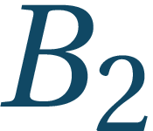
LOCC
Locally, entanglement cannot be created:
LOCC are changes to bipartite systems that include only local operations and classical communication (includes destroying state, measurements, usage additional local quantum ancillary states, throwing coins...)
Alice
Bob

Slide 28
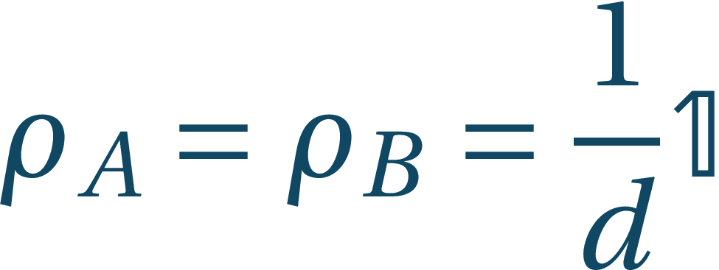
Separable states under LOCC
Set of separable states is by definition a set of convex combinations of factorized states – this are LOCC
By LOCC one can prepare any separable state from any other state – separable states are “weakest”
The “strongest” are the maximally entangled states from which one can prepare any other state by means of LOCC
One such state is
Partial traces always are

Slide 29
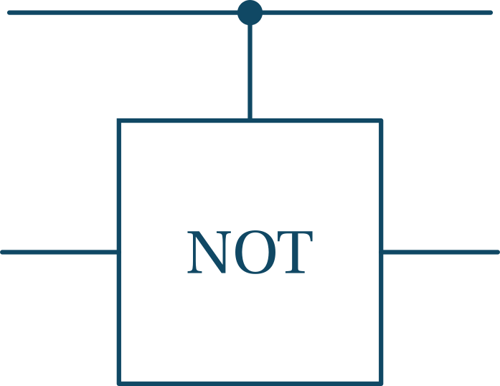
Entangled qubits
Locally it cannot be created, but global operations can do it
This is controlled NOT operation that applies NOT if and only if the first system is in state

Slide 30
Entangled qubits
Locally it cannot be created, but global operations can do it
This is controlled NOT operation that applies NOT if and only if the first system is in state

Slide 31
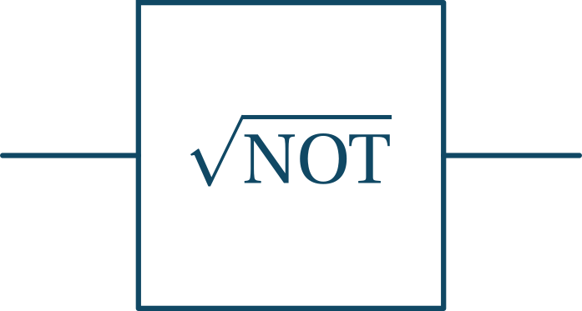
Entangled qubits
H
Locally it cannot be created, but global operations can do it
This is controlled NOT operation that applies NOT if and only if the first system is in state
We can see that it can make the maximally entangled states
universal quantum computation: H, C-NOT,

Slide 32
Bell basis
We were able to prepare states
These are orthogonal, but we can make a full basis of maximally entangled states by taking
Conversely we can write

Slide 33
Summary
Entanglement represents a new type of correlations between systems
They are different from classical correlations
Are these correlations stronger? Can we make use of them?

Slide 34
Non-locality
The mind-bending effect of entanglement

Slide 35
Singlet state
All Bell states are useful, but state has an interesting property, that it has the same form in every basis
In particular we can also write it as
This state is called singlet

Slide 36
EPR paradox
Einstein, Podolsky, Rosen (1935) – spooky action at a distance
Let us have entangled state:
Einstein, A; B Podolsky; N Rosen – Can Quantum-Mechanical Description of Physical Reality be Considered Complete?, Phys. Rev. 47, 777–780 (1935)

Slide 37
EPR paradox
Einstein, Podolsky, Rosen (1935) – spooky action at a distance
Let us have entangled state:
Alice: Earth
Bob: Andromeda galaxy
Einstein, A; B Podolsky; N Rosen – Can Quantum-Mechanical Description of Physical Reality be Considered Complete?, Phys. Rev. 47, 777–780 (1935)

Slide 38
EPR paradox
Einstein, Podolsky, Rosen (1935) – spooky action at a distance
Let us have entangled state:
If Alice measures in basis, then if she measures 0, she immediately knows Bob will measure 1 and if she measures 1, Bob will measure 0
Alice: Earth
Bob: Andromeda galaxy
Einstein, A; B Podolsky; N Rosen – Can Quantum-Mechanical Description of Physical Reality be Considered Complete?, Phys. Rev. 47, 777–780 (1935)

Slide 39
EPR paradox
Einstein, Podolsky, Rosen (1935) – spooky action at a distance
Let us have entangled state:
If Alice measures in basis, then if she measures 0, she immediately knows Bob will measure 1 and if she measures 1, Bob will measure 0
If Alice measures in basis, then if she measures +, she immediately knows Bob will measure – and if she measures –, Bob will measure +
Alice: Earth
Bob: Andromeda galaxy
Einstein, A; B Podolsky; N Rosen – Can Quantum-Mechanical Description of Physical Reality be Considered Complete?, Phys. Rev. 47, 777–780 (1935)

Slide 40
EPR paradox
This is paradoxical because:
It is reasonable to assume that the measurement in a galaxy far, far away.... cannot affect our state
But then, together with the strong correlation, it implies, that all the measurements outcomes have to be predetermined at the point of their creation
This in turn means that even the possibilities ruled out by the Heisenberg uncertainty principle are somehow determined for every state
EPR: As our description of states conforms to the uncertainty principle, it has to be incomplete
Bell: QM is weird; this incompleteness has measurable consequences

Slide 41
EPR paradox
Einstein, Podolsky, Rosen (1935) – spooky action at a distance
Let us have entangled state:
If Alice measures in basis, then whatever she measures, if Bob will decide to measure in the basis he will be getting the two basis states with equal probability
But he would be getting those even if Alice would measure in the basis (why?)
So they can reveal the “paradox” only after communicating – no FTL communication
Alice: Earth
Bob: Andromeda galaxy

Slide 42
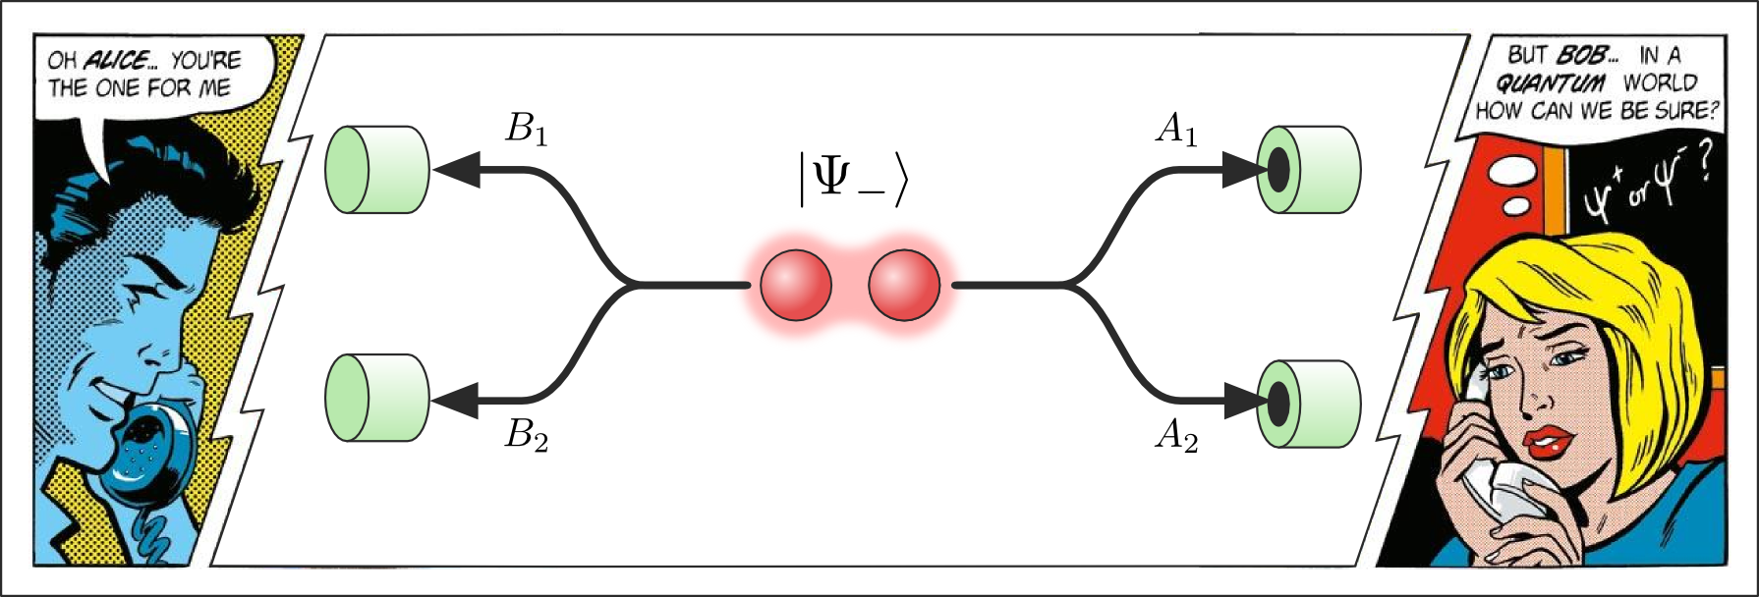
CHSH
J.S. Bell – On the Einstein Podolsky Rosen Paradox, Physics, 1: 195–200 (1964)
J.F. Clauser; M.A. Horne; A. Shimony; R.A. Holt – Proposed experiment to test local hidden-variable theories, Phys. Rev. Lett., 23: 880 (1969)
Measurements A and B have two-outcomes
They both gather statistics on their joint probability
(C) John Richardson

Slide 43
CHSH and local realism
From these probabilities they can compute correlation functions
Then they compute
It looks reasonable to assume (but do not take it for granted!) that the system obtains its properties during the preparation and these properties for each system determine what the results of different results will be (local realism):
Alice: Earth
Bob: Andromeda galaxy

Slide 44
CHSH and local realism
Let us compute
Under local realism where
Then
And so (CHSH inequality)
Alice: Earth
Bob: Andromeda galaxy

Slide 45
CHSH in the quantum case
Now let Alice and Bob share state
(C) John Richardson

Slide 46
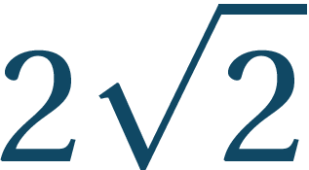
CHSH in the quantum case
Now let Alice and Bob share state
We now have
Taking (check the outcomes) we find:
The CHSH inequality is thus violated:
This violation is due to quantum correlations being different from classical
The violation of is maximal (Tsireľson bound)

Slide 47
Tsireľson bound
In quantum case we had (in general):
Using Cauchy-Schwarz inequality: where
Since we have
This function is maximal for giving Tsireľson bound

Slide 48
No-signaling
Conditions:
In no-signaling theories the violation of 4 is maximal (PR-box):
Then and
Alice: Earth
Bob: Andromeda galaxy

Slide 49
No-signaling
Quantum mechanics is no-signaling:
Let and , then and
Quantum theory thus does not possess the strongest possible correlations
Alice: Earth
Bob: Andromeda galaxy

Slide 50
Summary
Quantum systems can possess correlations beyond classical which have measurable consequences
These correlations lead to processes that are highly counter-intuitive
One cannot use these processes for FTL communication, but can use them to gain extra leverage over classical systems
The quantum correlations are detectable and including them in some protocols (QKD) can improve them

